Slide 1

DBA5103
Operations Research and Analytics
Zhenyu Hu
Semester I, 2026/2027

Slide 2
Duality Theory

Slide 3
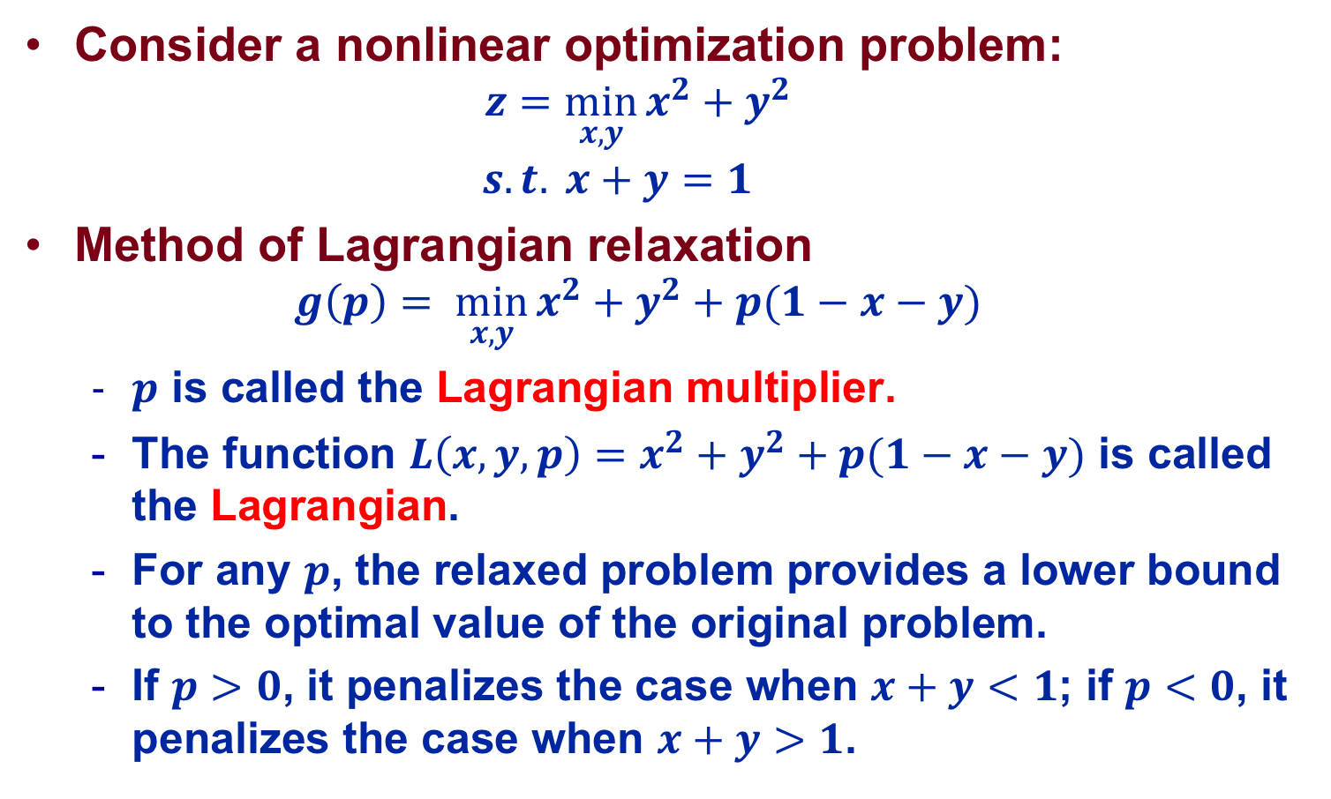
Motivating Example
Consider a nonlinear optimization problem:
  $$z=\min_{x, y}{x^{2}+y^{2}}$$
  $$s.t. x+y=1$$
Method of Lagrangian relaxation
  $$g\left(p\right)=\min_{x, y}{x^{2}+y^{2}}+p(1−x−y)$$
  $p$ is called the Lagrangian multiplier.
  The function ${L\left(x,y,p\right)=x}^{2}+y^{2}+p(1−x−y)$ is called the Lagrangian.
  For any $p$, the relaxed problem provides a lower bound to the optimal value of the original problem.
  If $p>0$, it penalizes the case when $x+y<1$; if $p<0$, it penalizes the case when $x+y>1$.

Slide 4
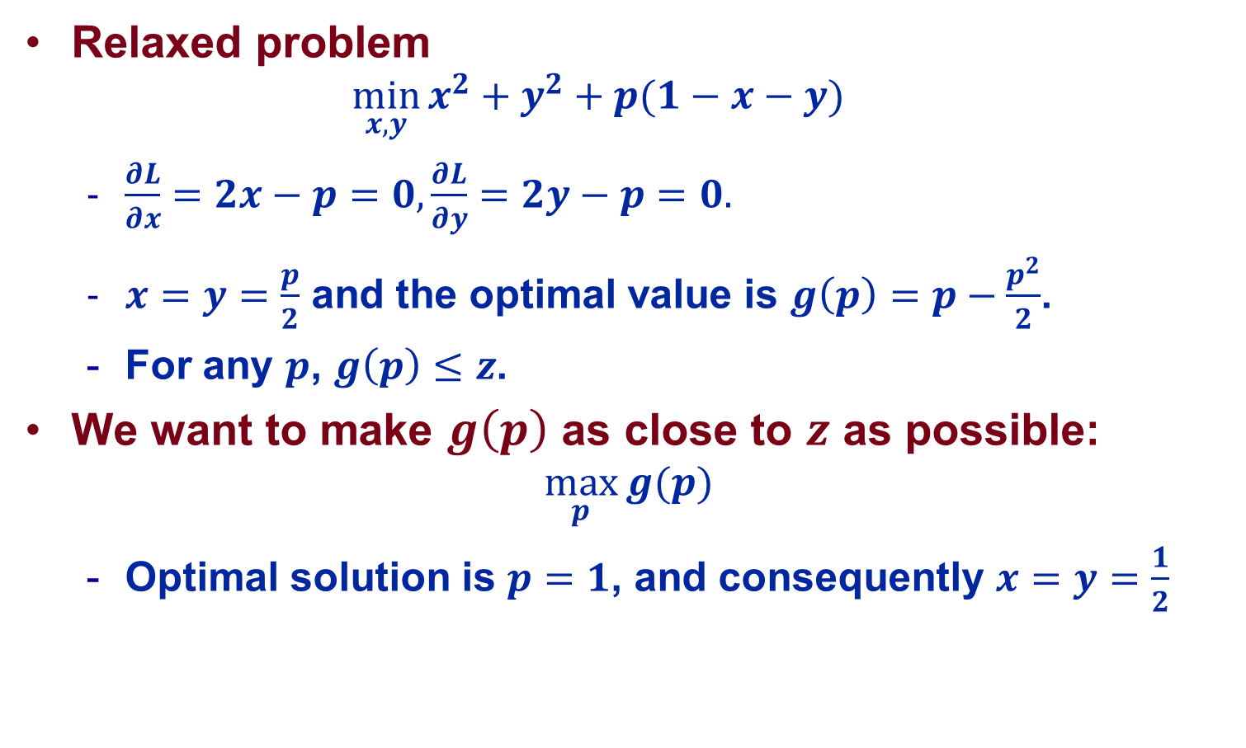
Motivating Example
Relaxed problem
  $$\min_{x, y}{x^{2}+y^{2}}+p(1−x−y)$$
  $\frac{∂L}{∂x}=2x−p=0,\frac{∂L}{∂y}=2y−p=0.$
  $x=y=\frac{p}{2}$ and the optimal value is $g\left(p\right)=p−\frac{p^{2}}{2}$.
  For any $p$, $g\left(p\right)≤z$.
We want to make $g\left(p\right)$ as close to $z$ as possible:
$$\max_{p}{g(p)}$$
  Optimal solution is $p=1$, and consequently $x=y=\frac{1}{2}$

Slide 5
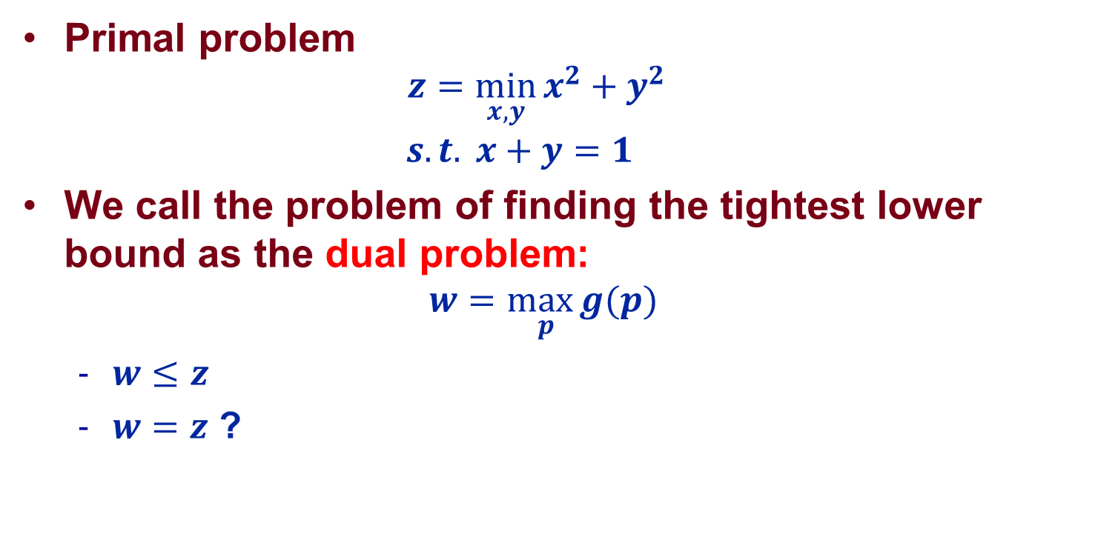



Summary
Primal problem
  $$z=\min_{x, y}{x^{2}+y^{2}}$$
  $$s.t. x+y=1$$
We call the problem of finding the tightest lower bound as the dual problem:
$$\underset{ p}{w=max}{g(p)}$$
  $w≤z$
  $w=z$ ?
$$primal problem$$
$$z$$
$$dual problem$$

Slide 6
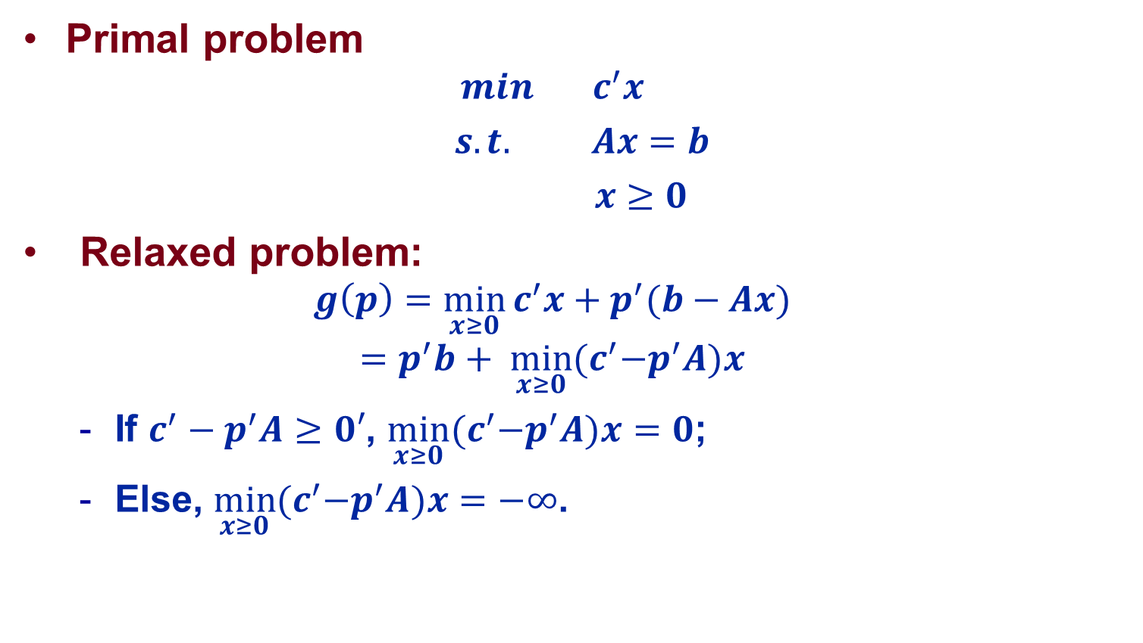
Duality in LP: Standard Form
Primal problem
  $$min c^{′}x$$
  $s.t. Ax=b$
  $x≥0$
Relaxed problem:
  $$g\left(p\right)=\min_{x≥0}{c^{′}x}+p^{′}(b−Ax)$$
  $$=p^{′}b+ \min_{x≥0}{{(c}^{′}−p^{′}A)x}$$
  If $c^{′}−p^{′}A≥0′$, $\min_{x≥0}{{(c}^{′}−p^{′}A)x}=0$;
  Else, $\min_{x≥0}{{(c}^{′}−p^{′}A)x}=−∞$.

Slide 7
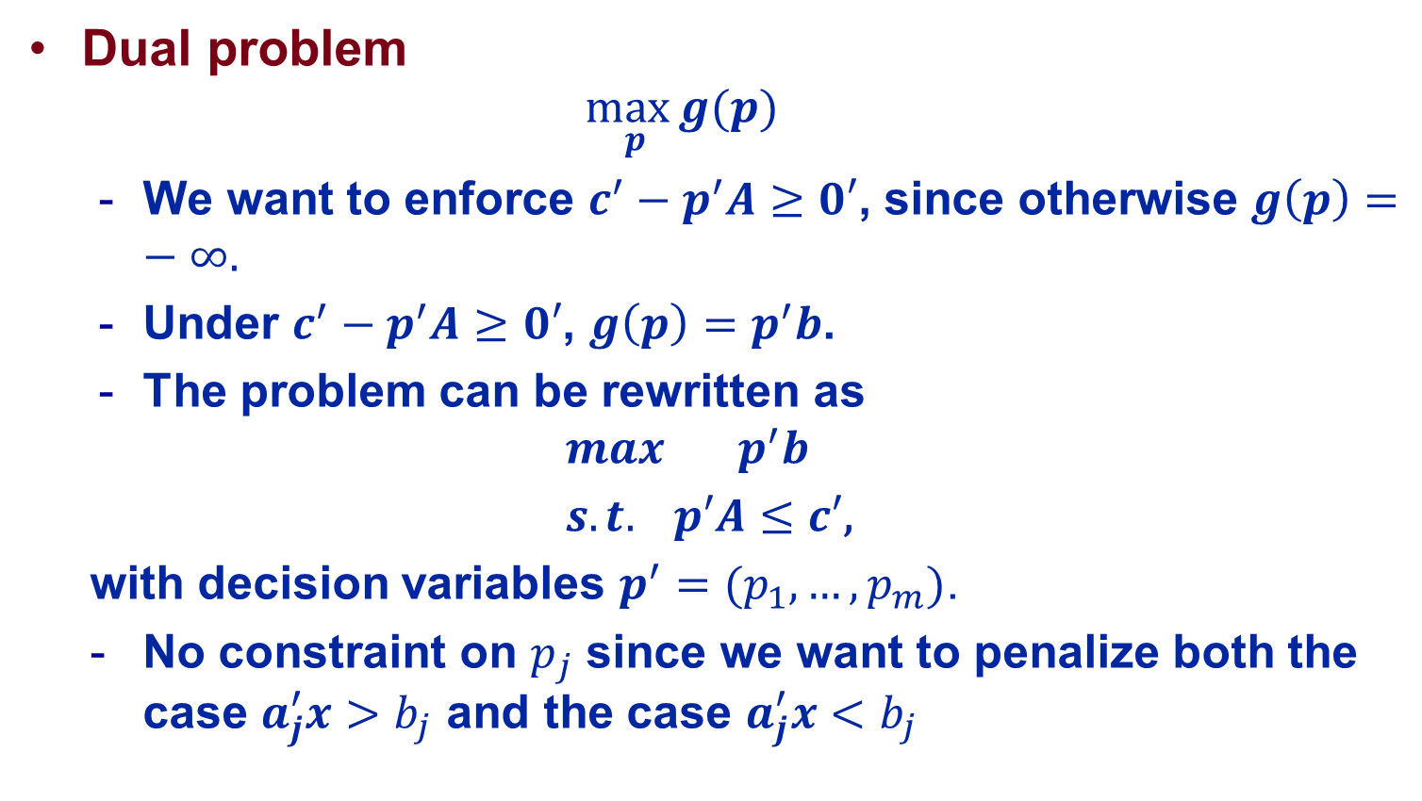
Duality in LP: Standard Form
Dual problem
  $$\max_{ p}{g(p)}$$
  We want to enforce $c^{′}−p^{′}A≥0′$, since otherwise $g\left(p\right)=−∞.$
  Under $c^{′}−p^{′}A≥0′$, $g\left(p\right)=p^{′}b$.
  The problem can be rewritten as
  $$max p^{′}b$$
  $s.t. p′A≤c′\text{,}$
  with decision variables $p^{′}=(p_{1},…,p_{m})$.
  No constraint on $p_{j}$ since we want to penalize both the case $a_{j}^{′}x>b_{j}$ and the case $a_{j}^{′}x<b_{j}$

Slide 8
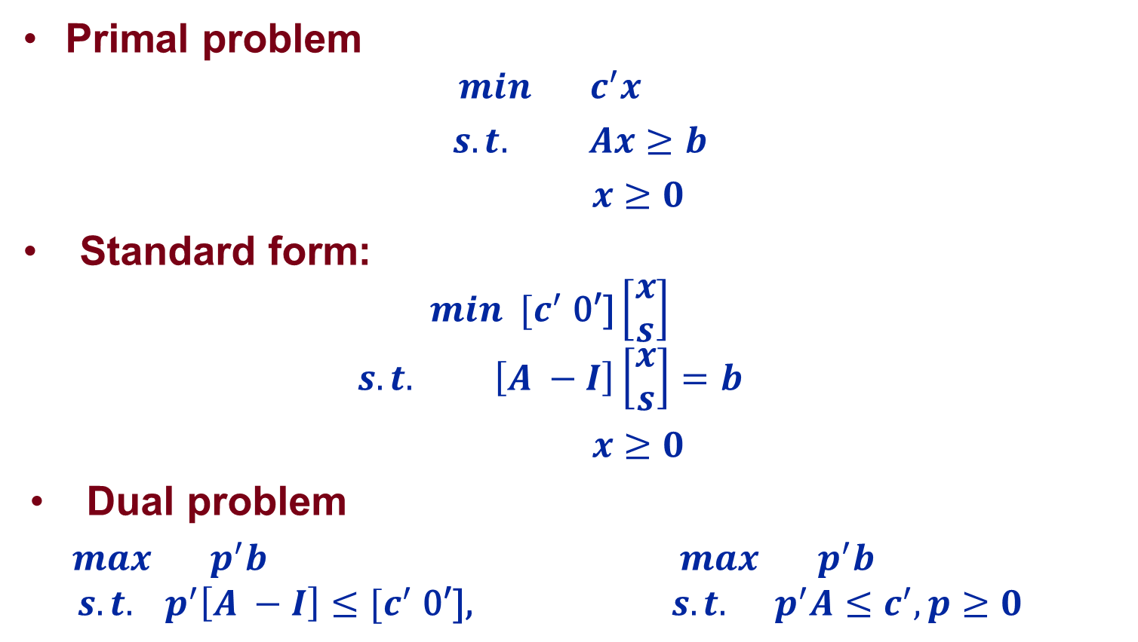
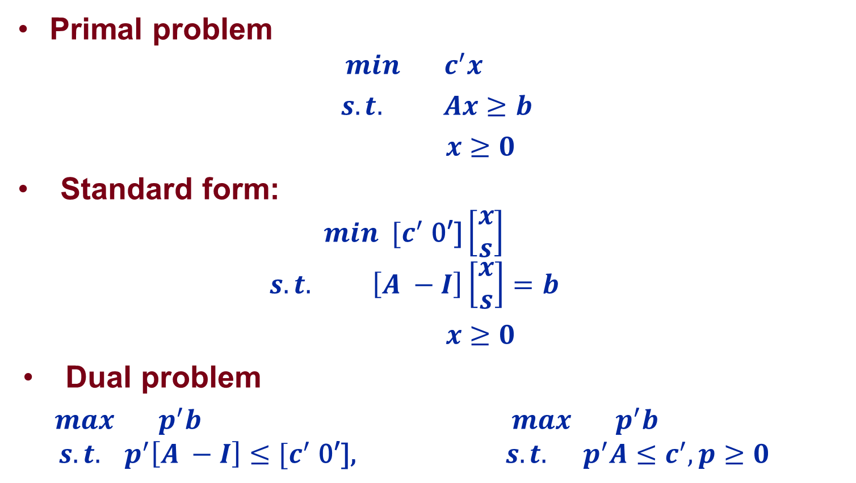
Variants
Primal problem
  $$min c^{′}x$$
  $s.t. Ax≥b$
  $x≥0$
Standard form:
  $$min [c^{′}\text{ 0′]}\left[\begin{aligned}x \\ s\end{aligned}\right]$$
  $$s.t. \left[A −I\right]\left[\begin{aligned}x \\ s\end{aligned}\right]=b$$
  $x≥0$
Dual problem
  $max p^{′}b$ $max p^{′}b$
  $$s.t. p^{′}\left[A −I\right]≤[c^{′}\text{ 0′],} s.t. { p}^{′}A≤c^{′},p≥0$$
Primal problem
  $$min c^{′}x$$
  $s.t. Ax≥b$
  $x≥0$
Standard form:
  $$min [c^{′}\text{ 0′]}\left[\begin{aligned}x \\ s\end{aligned}\right]$$
  $$s.t. \left[A −I\right]\left[\begin{aligned}x \\ s\end{aligned}\right]=b$$
  $x≥0$
Dual problem
  $max p^{′}b$ $max p^{′}b$
  $$s.t. p^{′}\left[A −I\right]≤[c^{′}\text{ 0′],} s.t. { p}^{′}A≤c^{′},p≥0$$

Slide 9
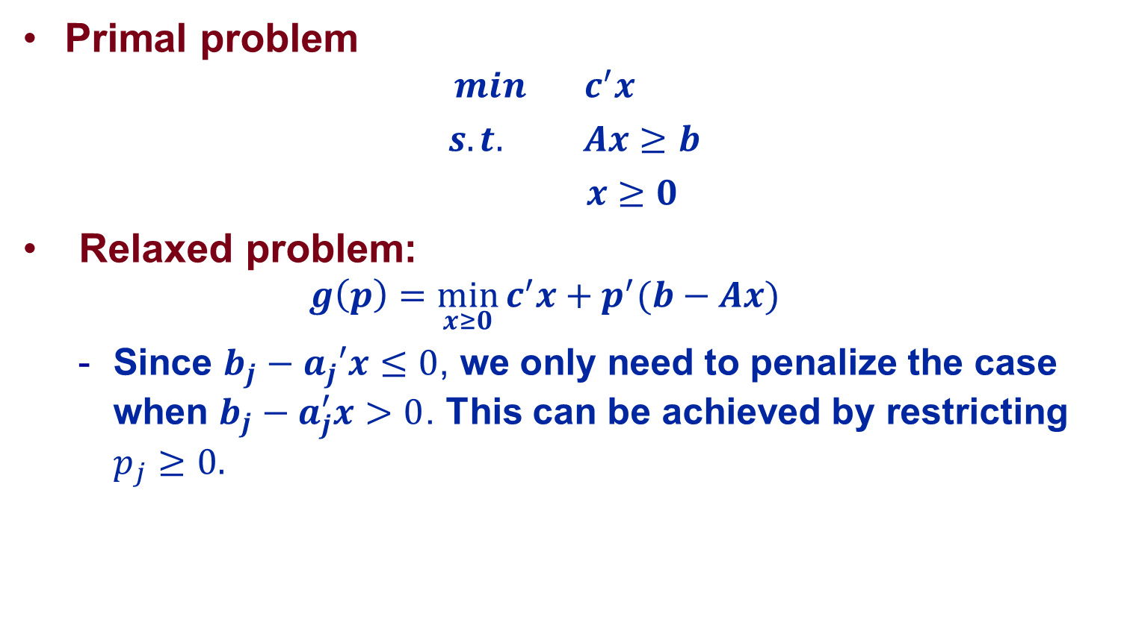

Variants: Intuition on $p≥0$
Primal problem
  $$min c^{′}x$$
  $s.t. Ax≥b$
  $x≥0$
Relaxed problem:
  $$g\left(p\right)=\min_{x≥0}{c^{′}x}+p^{′}(b−Ax)$$
  Since $b_{j}−a_{j}′x≤0$, we only need to penalize the case when $b_{j}−a_{j}^{′}x>0$. This can be achieved by restricting $p_{j}≥0.$

Slide 10
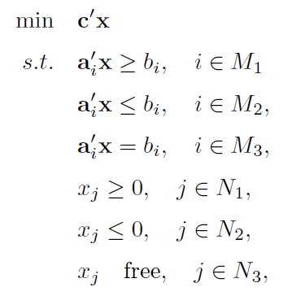
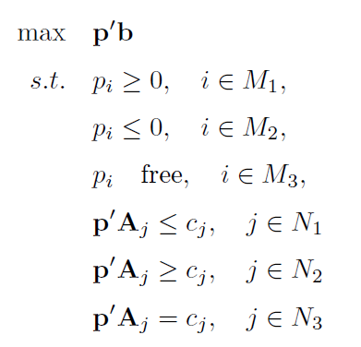
General Relationship

Slide 11
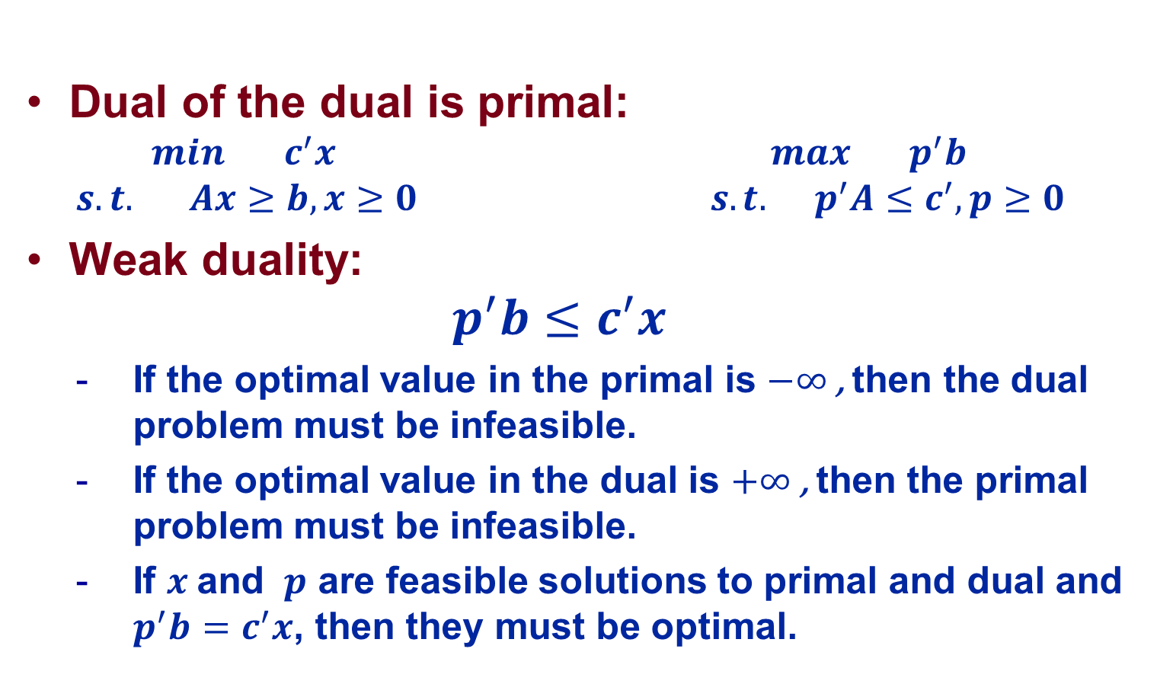
Duality Theory
Dual of the dual is primal:
  $$min c^{′}x max p^{′}b$$
  $$s.t. Ax≥b, x≥0 s.t. { p}^{′}A≤c^{′},p≥0$$
Weak duality:
  $$p^{′}b≤c^{′}x$$
  If the optimal value in the primal is $−∞$, then the dual problem must be infeasible.
  If the optimal value in the dual is $+∞$, then the primal problem must be infeasible.
  If $x$ and $p$ are feasible solutions to primal and dual and $p^{′}b=c^{′}x$, then they must be optimal.

Slide 12
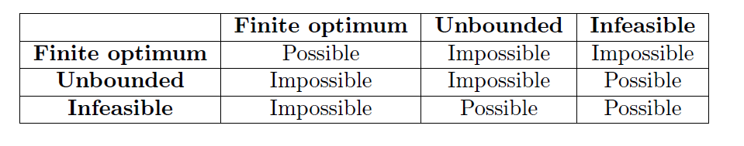
Duality Theory
Strong duality: If an LP has an optimal solution, then its dual also has a solution and the respective optimal value are equal.

Slide 13
Economic Interpretation of Duality

Slide 14
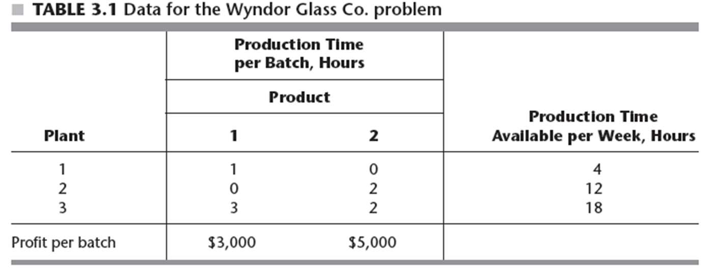
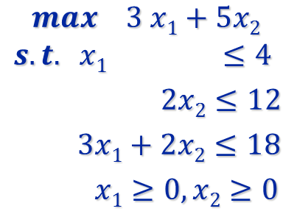
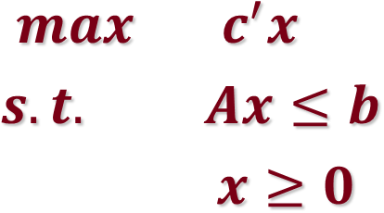
Production Example Revisited
LP formulation

Slide 15
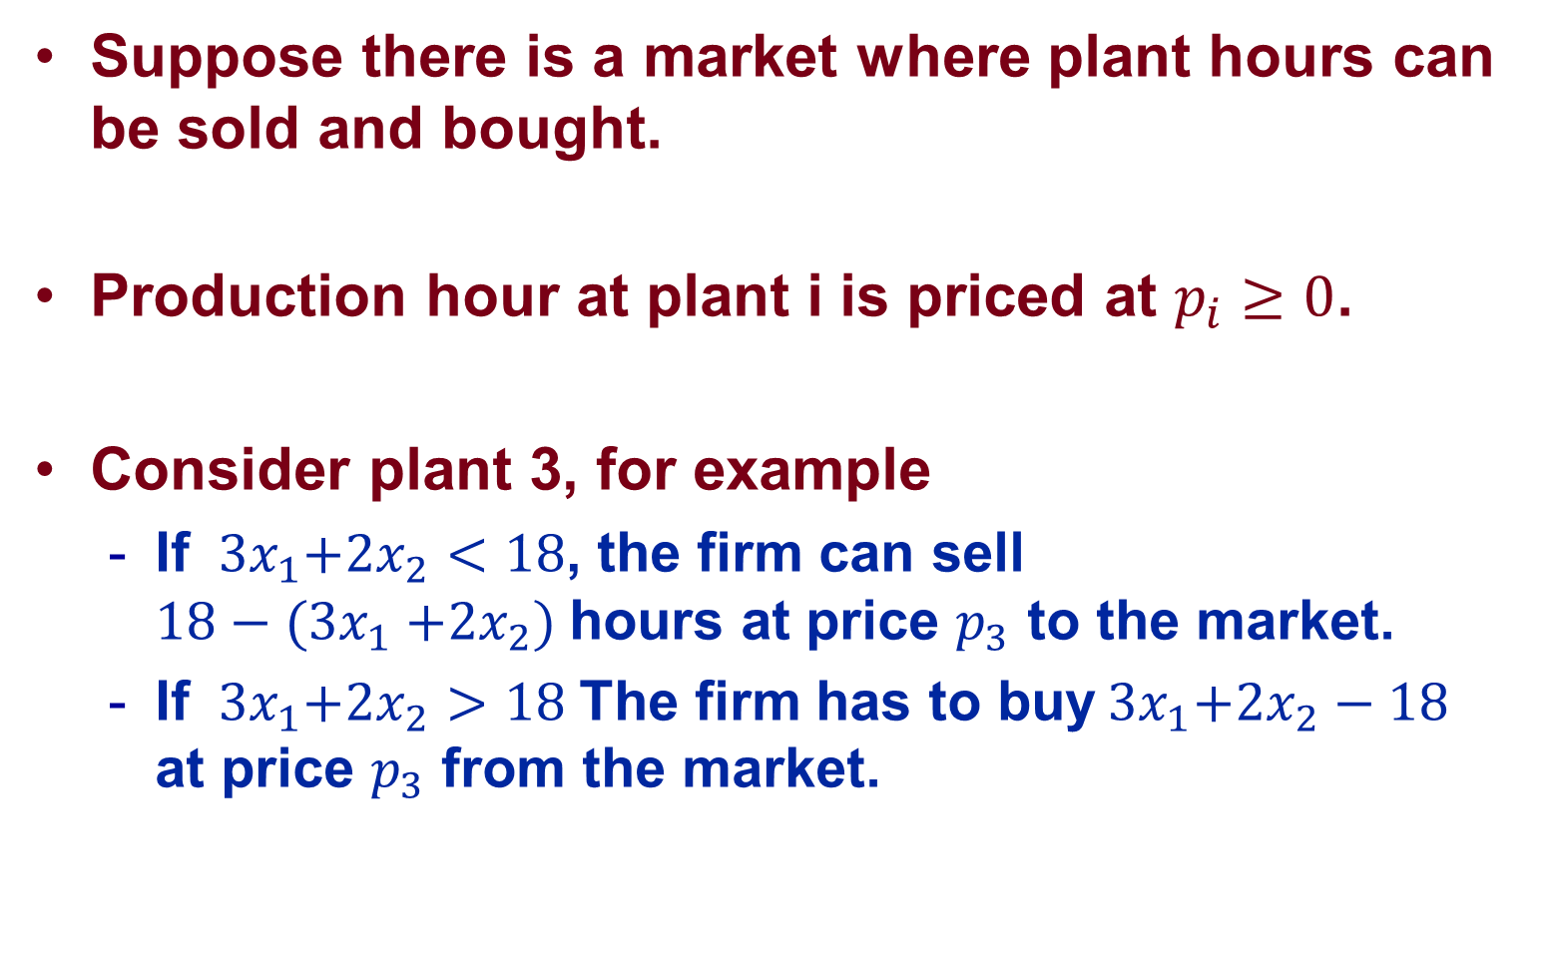
Production with Resource Market
Suppose there is a market where plant hours can be sold and bought.
Production hour at plant i is priced at $p_{i}≥0$.
Consider plant 3, for example
  If ${ 3x}_{1}+{2x}_{2}<18$, the firm can sell $18{− (3x}_{1}+{2x}_{2})$hours at price $p_{3}$ to the market.
  If ${ 3x}_{1}+{2x}_{2}>18$The firm has to buy${ 3x}_{1}+{2x}_{2}−18$ at price $p_{3}$ from the market.

Slide 16
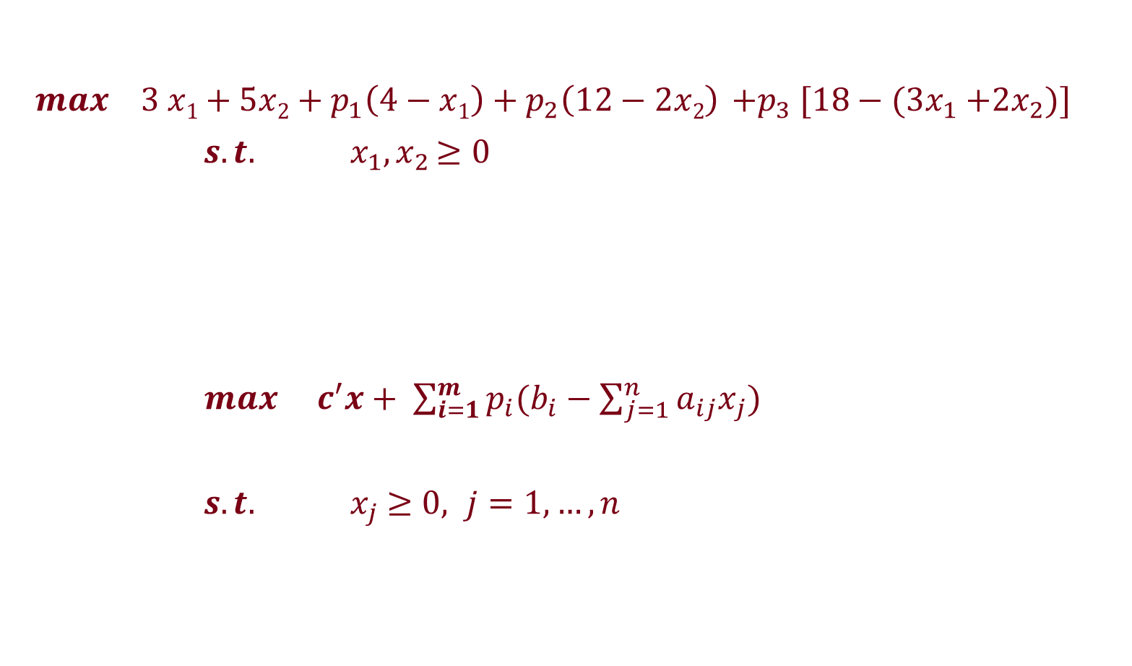
Production with Resource Market
$max 3 x1+5x2+p_{1}\left(4−x1\right)+p_{2}\left(12−2x2\right) {+p}_{3}[18{− (3x}_{1}+{2x}_{2})]$
$s.t.$ ${ x}_{1}{, x}_{2}≥0$
$max{ c}^{′}x+ \sum_{i=1}^{m}{p_{i}(b_{i}−\sum_{j=1}^{n}{a_{ij}x_{j})}}$
$s.t.$ ${ x}_{j} ≥0, j=1,…,n$

Slide 17
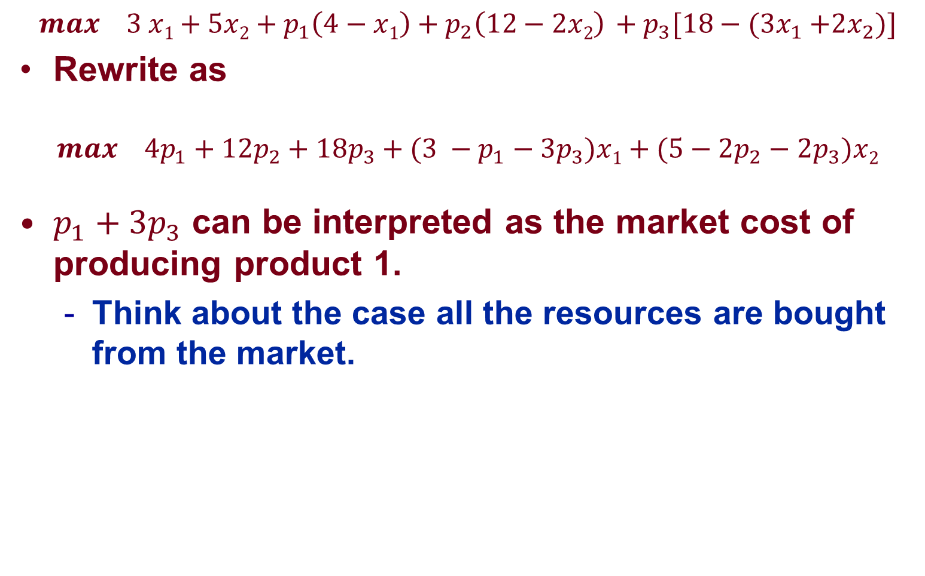
Production with Resource Market
$$max 3 x1+5x2+p_{1}\left(4−x1\right)+p_{2}\left(12−2x2\right) +p_{3}[18{− (3x}_{1}+{2x}_{2})]$$
Rewrite as
$$max 4p_{1}+12p_{2}+18p_{3}+(3 −p_{1}−3p_{3})x1+(5−{2p}_{2}−2p_{3})x2$$
$p_{1}+3p_{3}$ can be interpreted as the market cost of producing product 1.
  Think about the case all the resources are bought from the market.
At what price should the market price the plant hours?

Slide 18
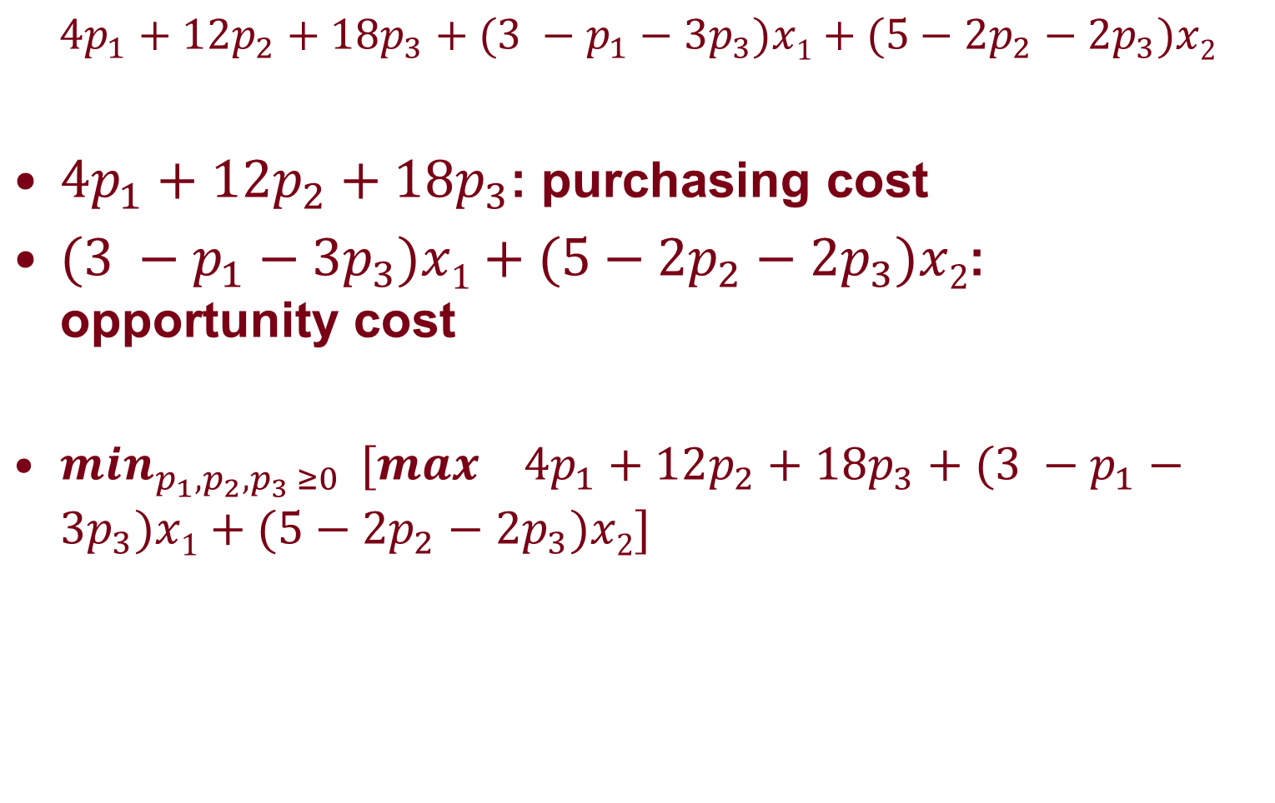
Market Perspective
$$4p_{1}+12p_{2}+18p_{3}+(3 −p_{1}−3p_{3})x1+(5−2p_{2}−2p_{3})x2$$
$4p_{1}+12p_{2}+18p_{3}$: purchasing cost
$(3 −p_{1}−3p_{3})x1+(5−{2p}_{2}−2p_{3})x2$: opportunity cost
$\min_{p_{1},p_{2},p_{3 }≥0 } [max 4p_{1}+12p_{2}+18p_{3}+(3 −p_{1}−3p_{3})x1+(5−{2p}_{2}−2p_{3})x2]$

Slide 19
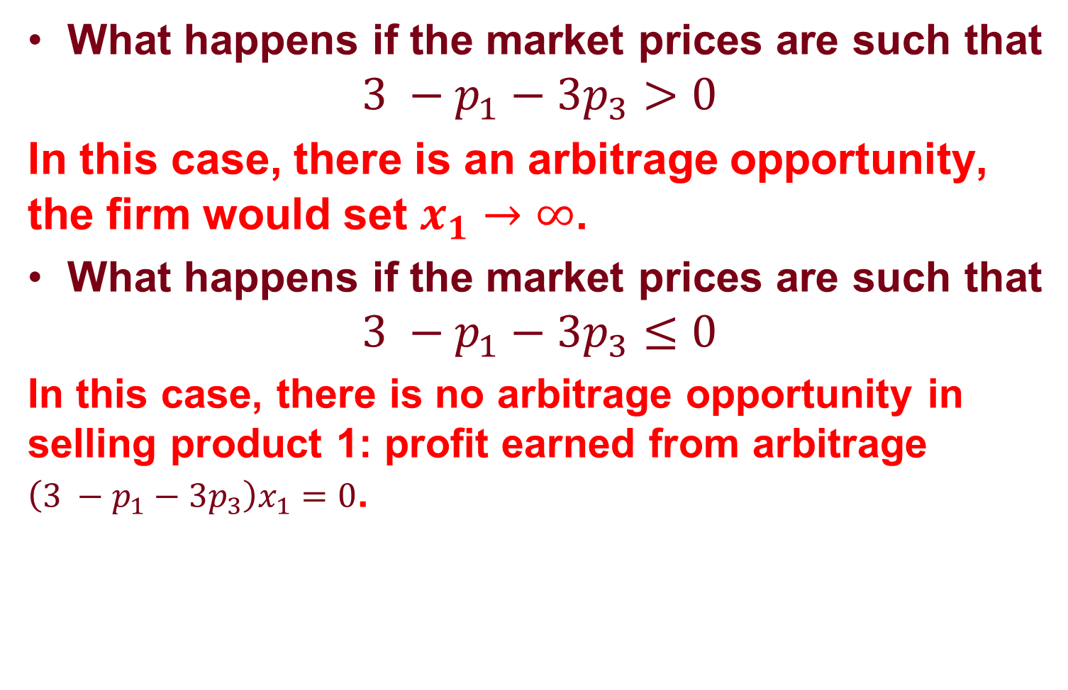
Market Perspective
What happens if the market prices are such that
$$3 −p_{1}−3p_{3}>0$$
In this case, there is an arbitrage opportunity, the firm would set $x_{1}→∞$.
What happens if the market prices are such that
$$3 −p_{1}−3p_{3}≤0$$
In this case, there is no arbitrage opportunity in selling product 1: profit earned from arbitrage $\left(3 −p_{1}−3p_{3}\right)x_{1}=0$.

Slide 20
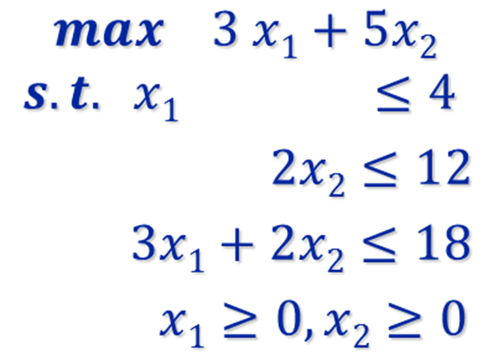
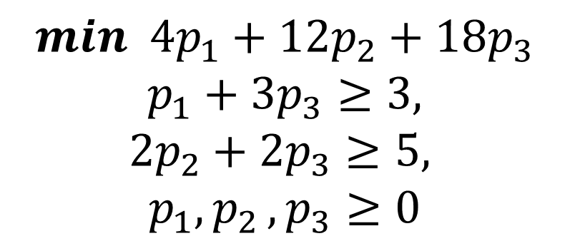
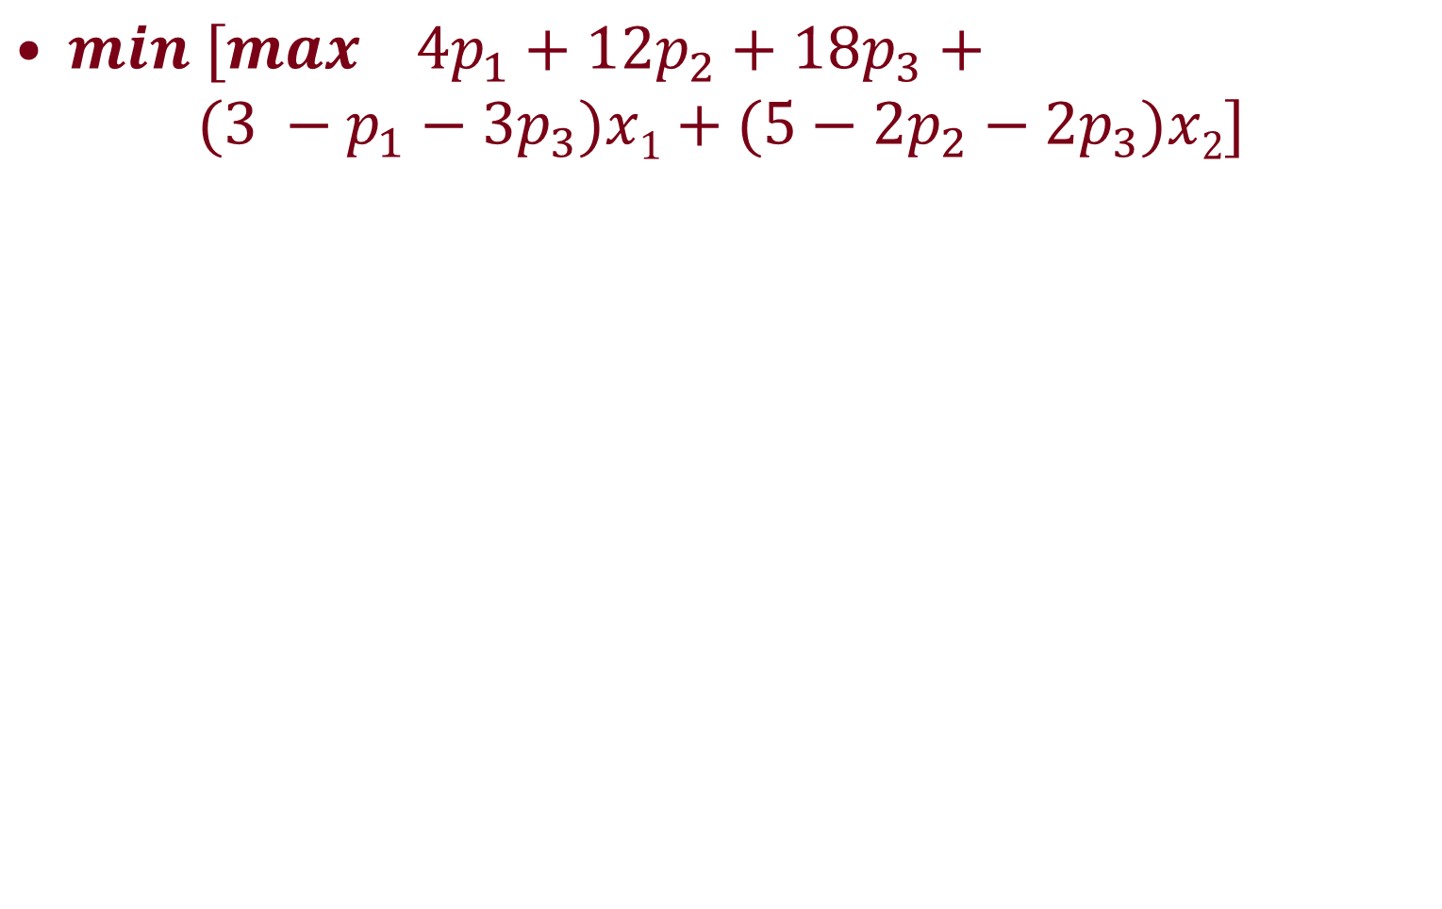
Market Perspective
$min [max 4p_{1}+12p_{2}+18p_{3}+$
$$(3 −p_{1}−3p_{3})x1+(5−2p_{2}−2p_{3})x2]$$
$$min 4p_{1}+12p_{2}+18p_{3}$$
$$p_{1}+3p_{3}≥3,$$
$${2p}_{2}+2p_{3}≥5,$$
$$p_{1}{,p}_{2},p_{3}≥0$$

Slide 21
Solution
We know primal solution is (2, 6) with optimal profit 36K.
Is (0, 1.5, 1) an optimal solution to the dual?
$$min 4p_{1}+12p_{2}+18p_{3}$$
$$p_{1}+3p_{3}≥3,$$
$${2p}_{2}+2p_{3}≥5,$$
$$p_{1}{,p}_{2},p_{3}≥0$$

Slide 22
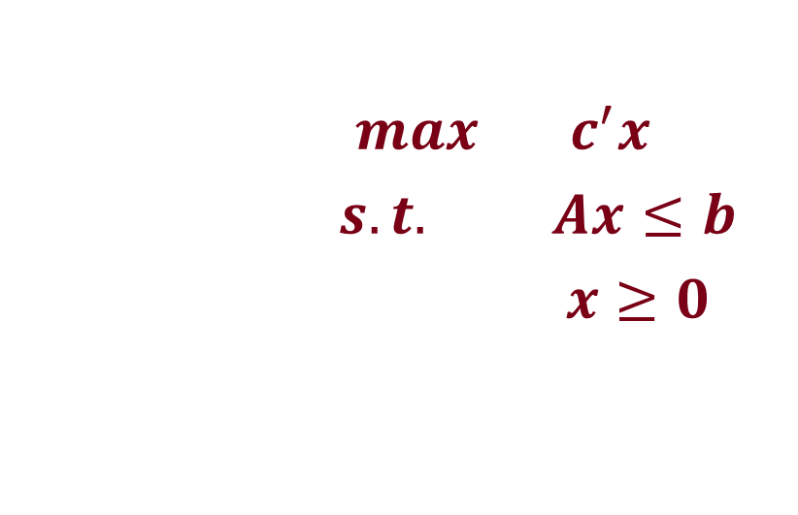
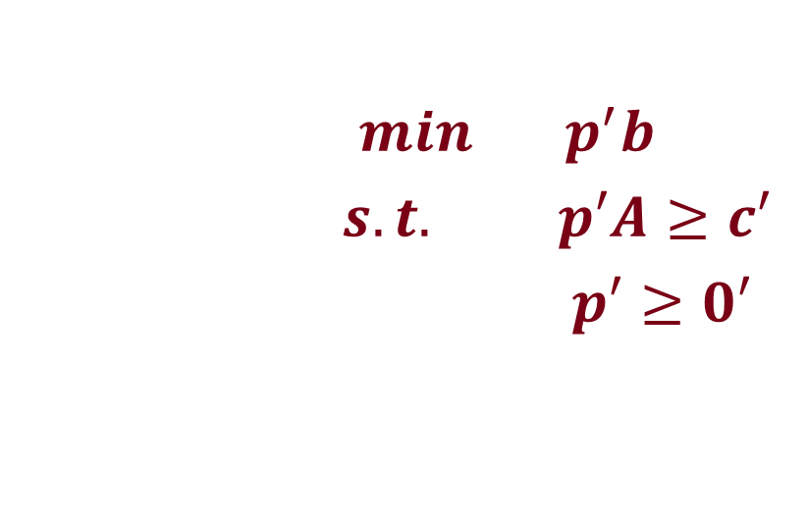
Firm and the Market
$max c^{′}x$
$s.t. Ax≤b$
$x≥0$
$min p^{′}b$
$s.t. p′A≥c′$
$p′≥0′$

Slide 23
Summary
The primal problem: a firm seeks to maximize its profit by producing products from available resources.
The dual problem: a market seeks to eliminate the arbitrage opportunities by choosing the right prices for resources.
Dual variables are also called shadow prices.

Slide 24
Sensitivity Analysis

Slide 25
Motivation
In practice, it is rarely sufficient to solve a single LP to arrive at good decisions.
  The problem data may depend on some higher level decisions (strategic-level rather than operational-level)
  Part of the problem data maybe controllable at an additional cost
  Incomplete knowledge of problem data (randomness)

Slide 26
Sensitivity Analysis
Possible changes in data require sensitivity analysis.
Sensitivity analysis: “What if” analysis
We put more focus on the optimal value

Slide 27
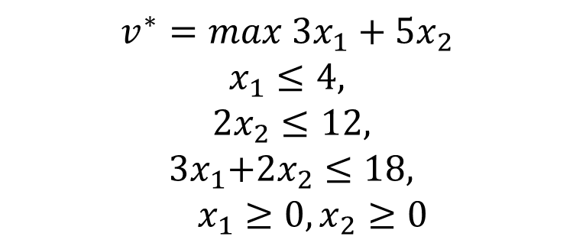
Production Example Revisited
LP formulation
$$v^{∗}=max{ 3x}_{1}+{5x}_{2}$$
$$x_{1}≤4,$$
$$2x_{2}≤12,$$
$${ 3x}_{1}+{2x}_{2}≤18,$$
$x_{1}≥0,x_{2}≥0$

Slide 28
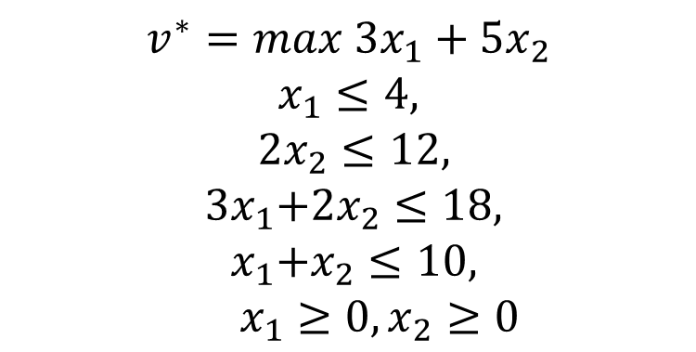
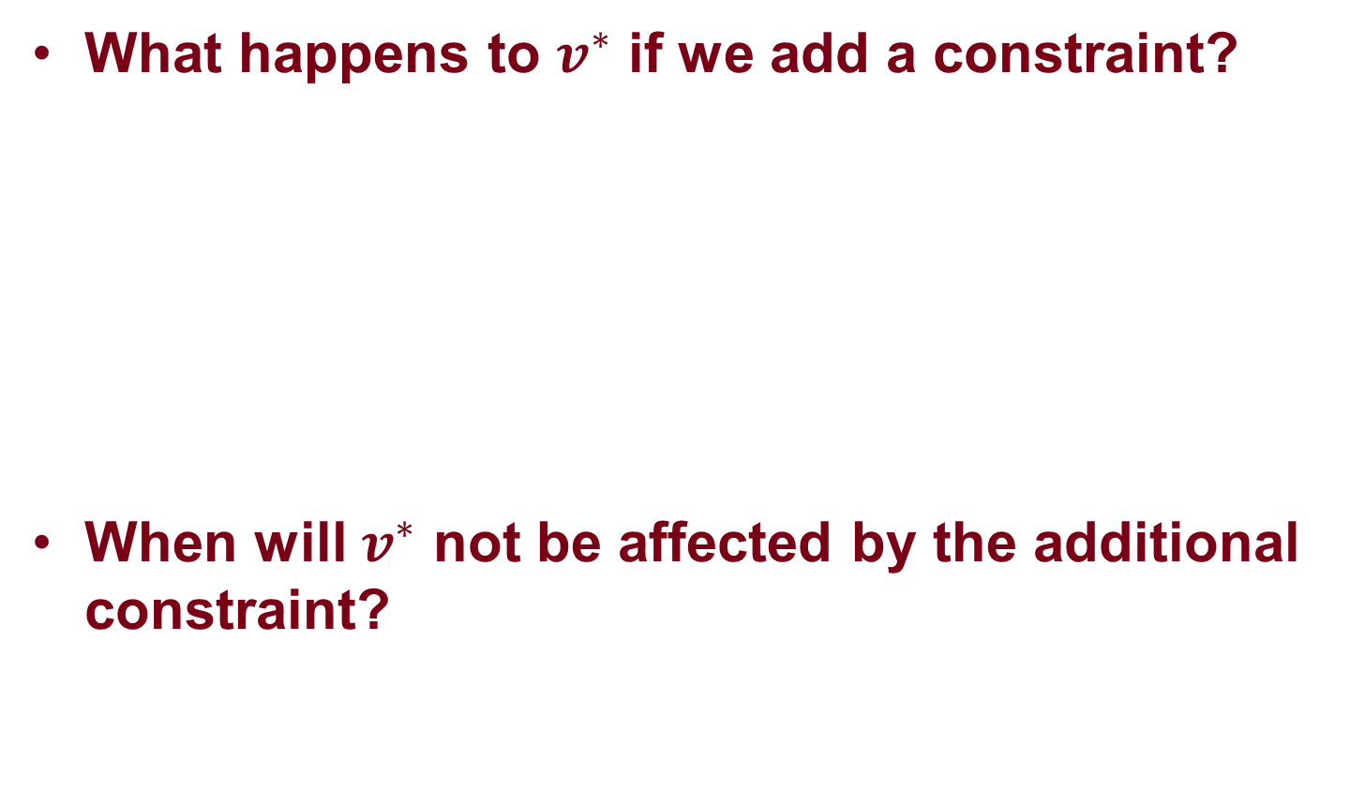
Adding a Constraint
What happens to $v^{∗}$ if we add a constraint?
When will $v^{∗}$ not be affected by the additional constraint?
$$v^{∗}=max{ 3x}_{1}+{5x}_{2}$$
$$x_{1}≤4,$$
$$2x_{2}≤12,$$
$${ 3x}_{1}+{2x}_{2}≤18,$$
$${ x}_{1}+x_{2}≤10,$$
$x_{1}≥0,x_{2}≥0$
A new plant dedicated for packaging

Slide 29
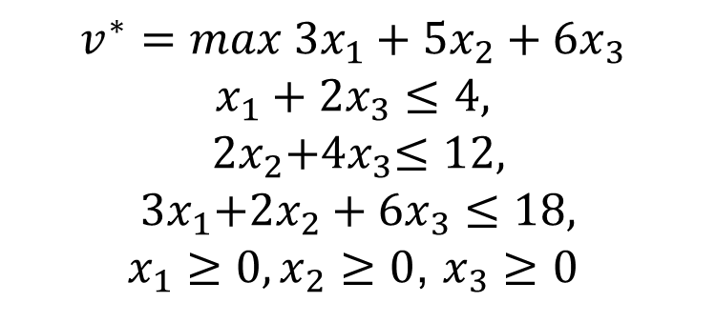
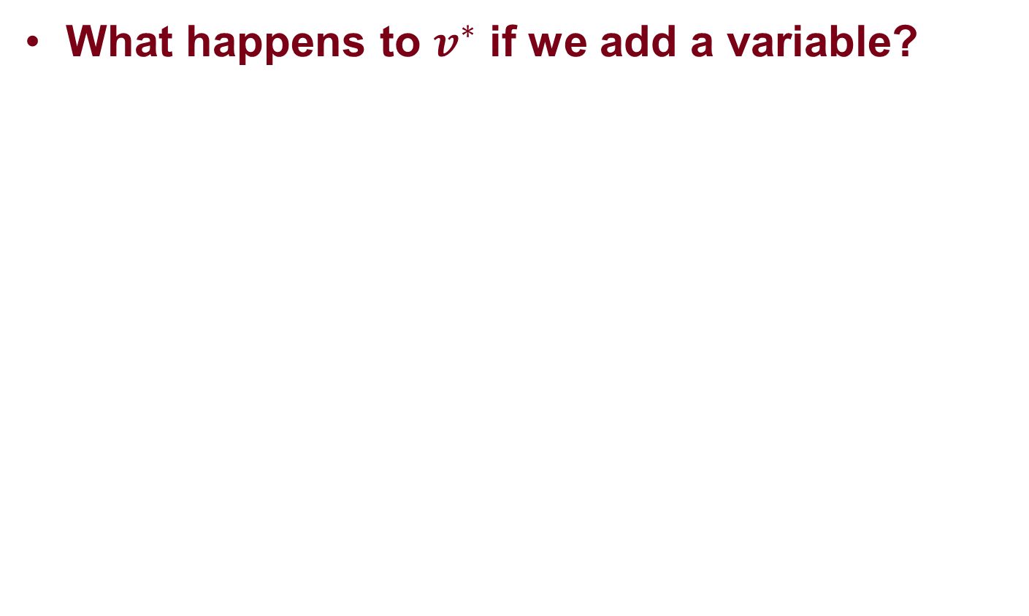

Adding a New Variable
What happens to $v^{∗}$ if we add a variable?
$$v^{∗}=max{ 3x}_{1}+{5x}_{2}+{6x}_{3}$$
$$x_{1}+{2x}_{3}≤4,$$
$$2x_{2}{+4x}_{3}≤12,$$
$${ 3x}_{1}+{2x}_{2}+{6x}_{3}≤18,$$
$x_{1}≥0,x_{2}≥0$, $x_{3}≥0$
Consider $\left({ x}_{1},x_{2},x_{3}\right)=\left(2,6,0\right)$. Is it a BFS?

Slide 30
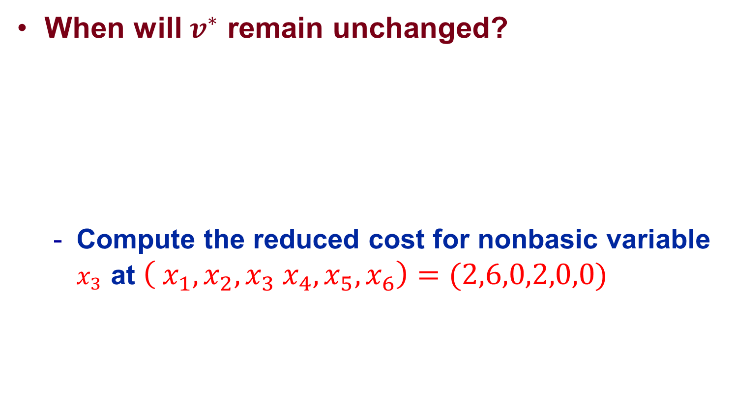
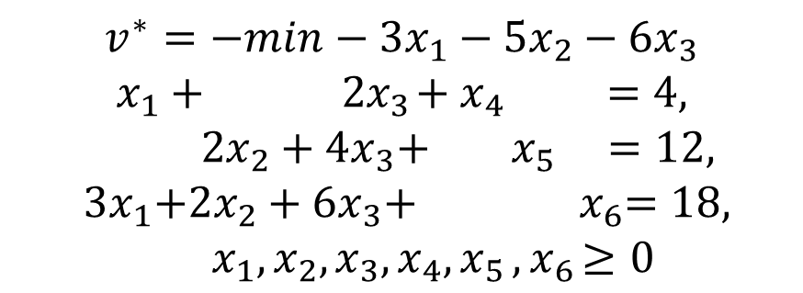
Adding a New Variable
When will $v^{∗}$ remain unchanged?
  Compute the reduced cost for nonbasic variable $x_{3}$ at $\left({ x}_{1},x_{2},x_{3}{ x}_{4},x_{5},x_{6}\right)=(2,6,0,2,0,0)$
$$v^{∗}=−min−3x_{1}−{5x}_{2}−{6x}_{3}$$
$$x_{1}+ { 2x}_{3}+{ x}_{4} =4,$$
$$2x_{2}+{4x}_{3}+{ x}_{5 }=12,$$
$${ 3x}_{1}+{2x}_{2}+{6x}_{3}+{ x}_{6}=18,$$
$x_{1},x_{2}, x_{3},x_{4}{, x}_{5}{, x}_{6}≥0$

Slide 31
Controllable Data Inputs
Available resources
Prices

Slide 32
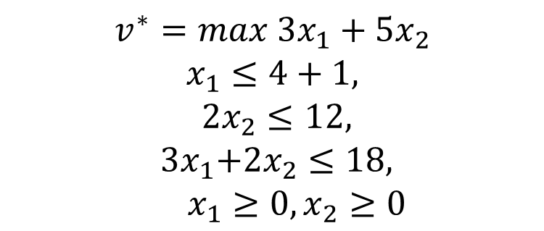
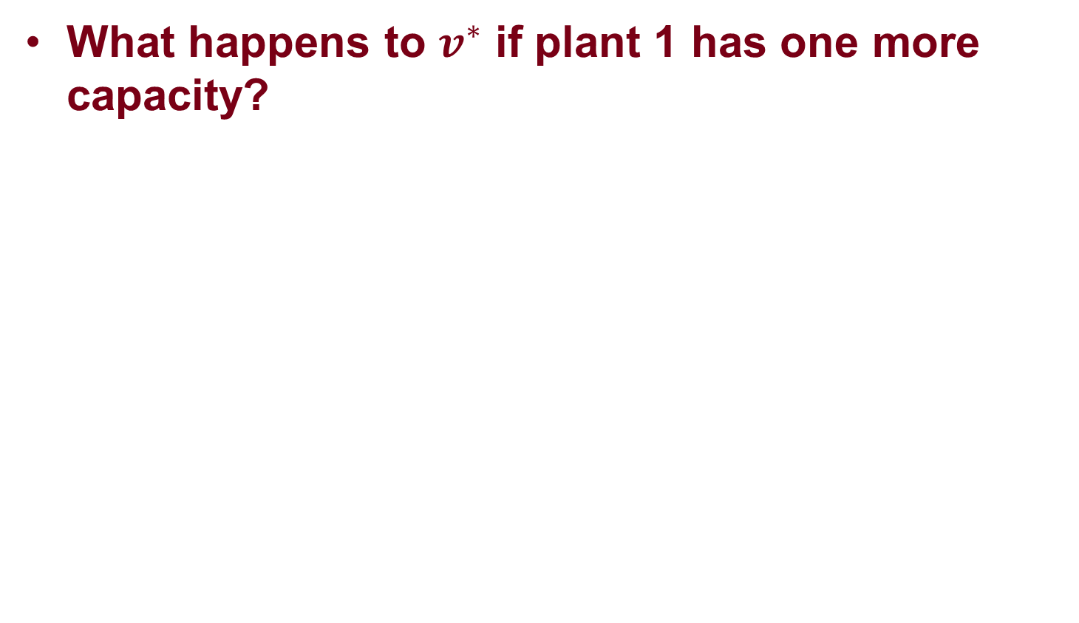
Change in resource
What happens to $v^{∗}$ if plant 1 has one more capacity?
$$v^{∗}=max{ 3x}_{1}+{5x}_{2}$$
$$x_{1}≤4+1,$$
$$2x_{2}≤12,$$
$${ 3x}_{1}+{2x}_{2}≤18,$$
$x_{1}≥0,x_{2}≥0$

Slide 33
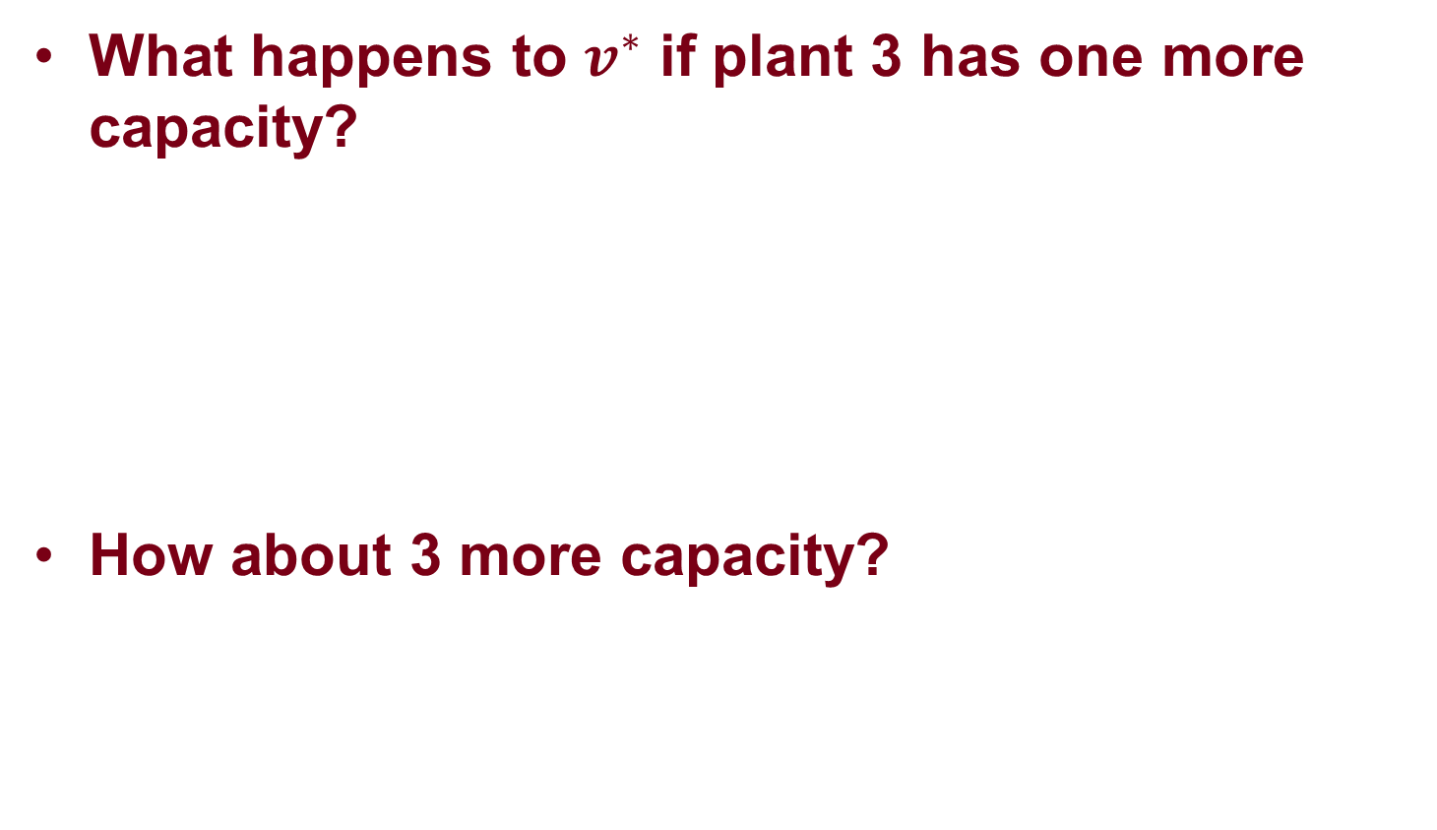
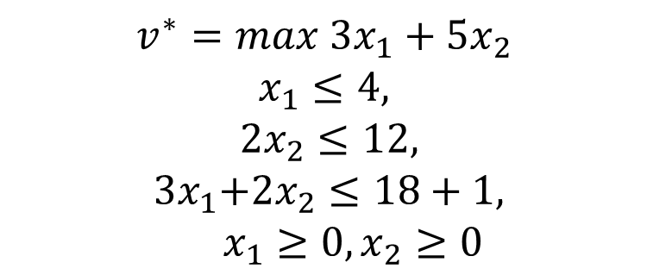
Change in resource
What happens to $v^{∗}$ if plant 3 has one more capacity?
How about 3 more capacity?
$$v^{∗}=max{ 3x}_{1}+{5x}_{2}$$
$$x_{1}≤4,$$
$$2x_{2}≤12,$$
$${ 3x}_{1}+{2x}_{2}≤18+1,$$
$x_{1}≥0,x_{2}≥0$
Notes:
At (2, 6), we can only increase the profit by producing more x_1.

Slide 34
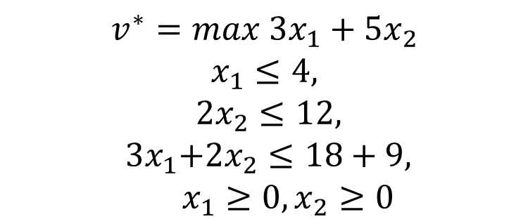
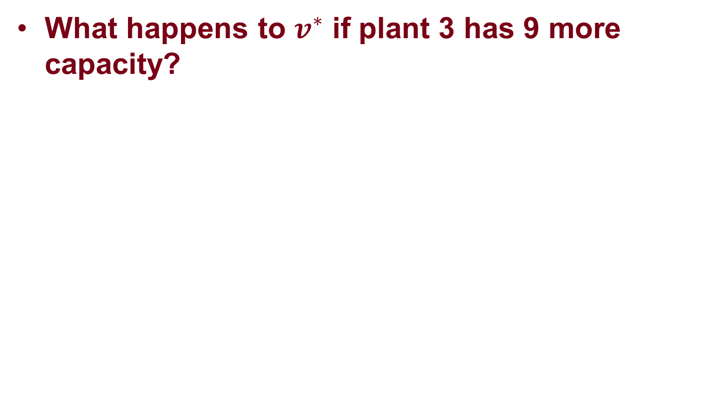
Change in resource
What happens to $v^{∗}$ if plant 3 has 9 more capacity?
$$v^{∗}=max{ 3x}_{1}+{5x}_{2}$$
$$x_{1}≤4,$$
$$2x_{2}≤12,$$
$${ 3x}_{1}+{2x}_{2}≤18+9,$$
$x_{1}≥0,x_{2}≥0$

Slide 35
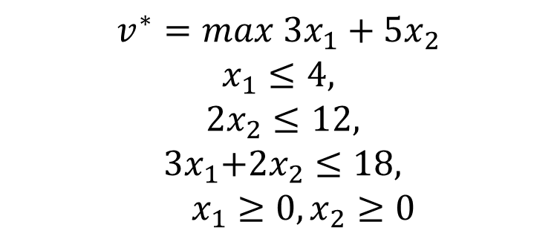

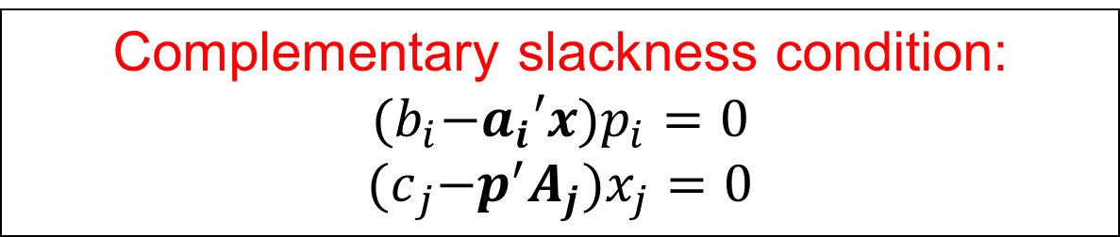


Relation with Shadow Price
Shadow price for the plant constraints
$$v^{∗}=max{ 3x}_{1}+{5x}_{2}$$
$$x_{1}≤4,$$
$$2x_{2}≤12,$$
$${ 3x}_{1}+{2x}_{2}≤18,$$
$x_{1}≥0,x_{2}≥0$
$$p_{1}=0$$
$$p_{2}=1.5$$
$$p_{3}=1$$
Complementary slackness condition: ${(b}_{i}−a_{i}′x)p_{i}=0$
$${(c}_{j}−p^{′}A_{j})x_{j}=0$$

Slide 36
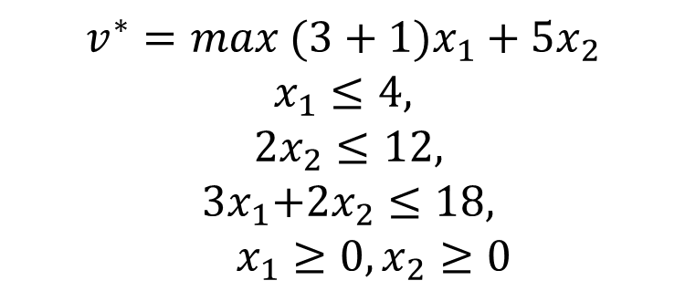
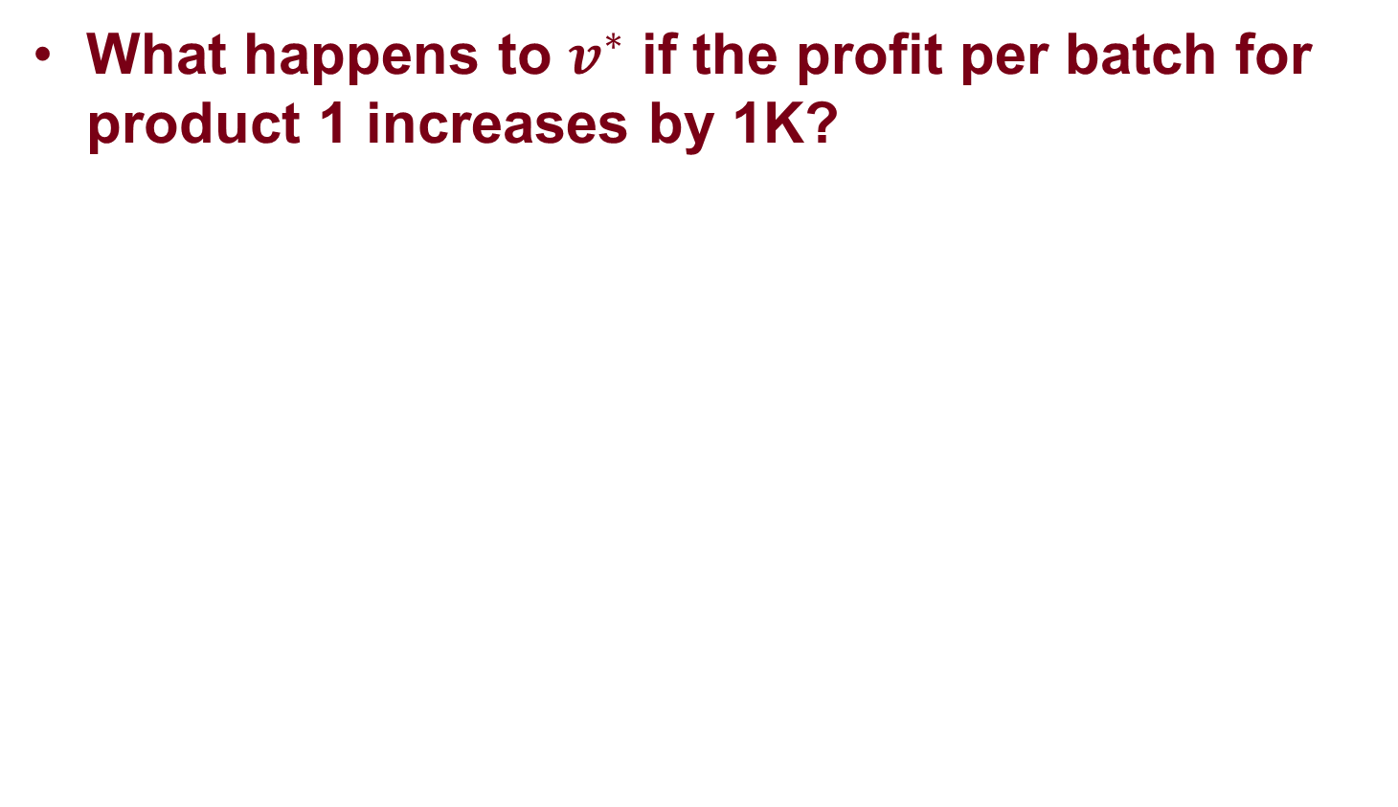
Change in Price
What happens to $v^{∗}$ if the profit per batch for product 1 increases by 1K?
$$v^{∗}=max{ (3+1)x}_{1}+{5x}_{2}$$
$$x_{1}≤4,$$
$$2x_{2}≤12,$$
$${ 3x}_{1}+{2x}_{2}≤18,$$
$x_{1}≥0,x_{2}≥0$
At least increase by 2K.

Slide 37
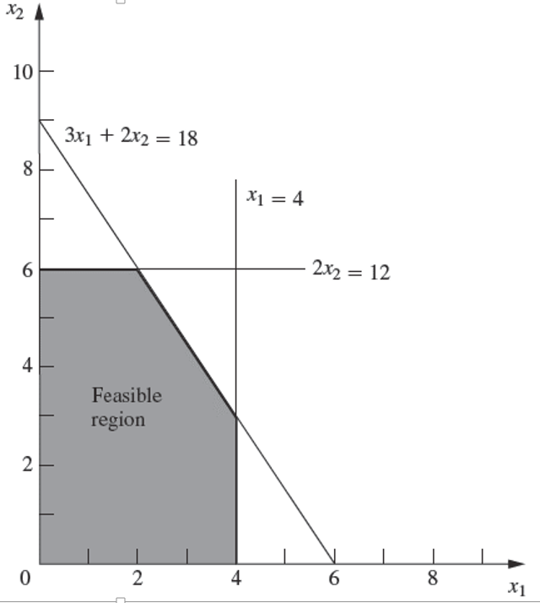


Change in Price
  Reduced cost changes but still all positive:
  optimal solution remains unchanged and
  profit increase is exactly 2K.
$${3x}_{1}+{5x}_{2}=10$$
$${4x}_{1}+{5x}_{2}=10$$

Slide 38
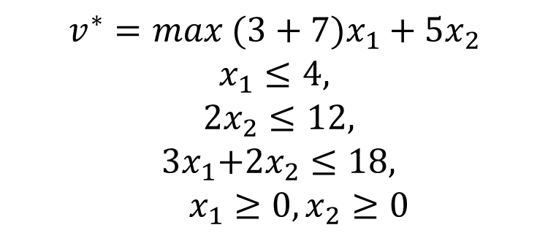
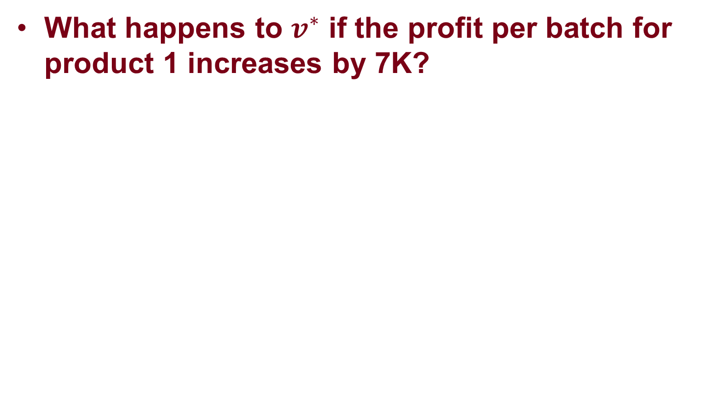
Change in Price
What happens to $v^{∗}$ if the profit per batch for product 1 increases by 7K?
$$v^{∗}=max{ (3+7)x}_{1}+{5x}_{2}$$
$$x_{1}≤4,$$
$$2x_{2}≤12,$$
$${ 3x}_{1}+{2x}_{2}≤18,$$
$x_{1}≥0,x_{2}≥0$
At least increase by 14K.

Slide 39

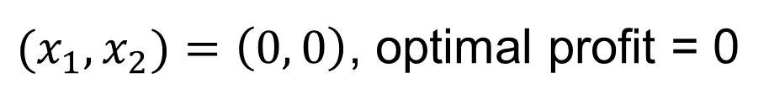
Change in Price
  Reduced cost for the slack variable of the constraint: $2x_{2}≤12$becomes negative:
  solution moves away from $(2,6,2,0,0)$ to $(4,3,0,6,0)$.
  Profit increase: 19K.
$${3x}_{1}+{5x}_{2}=10$$
$${10x}_{1}+{5x}_{2}=10$$

Slide 40
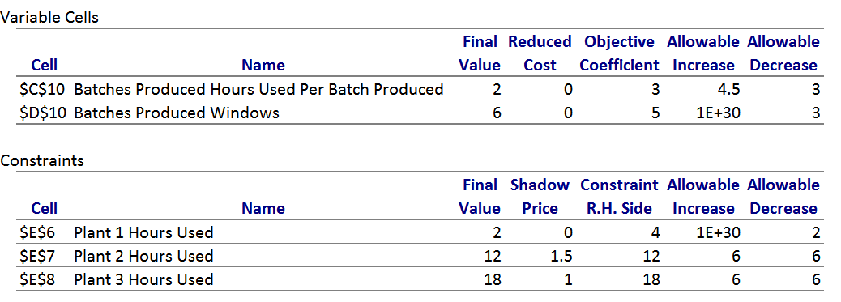
Sensitivity Report (Excel)

Slide 41
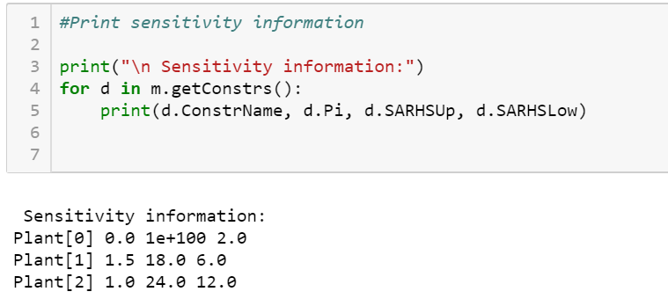
Sensitivity Report (Gurobi)
Reference: http://www.gurobi.com/documentation/8.1/refman/linear_constraint_attribut.html

